Slide 1
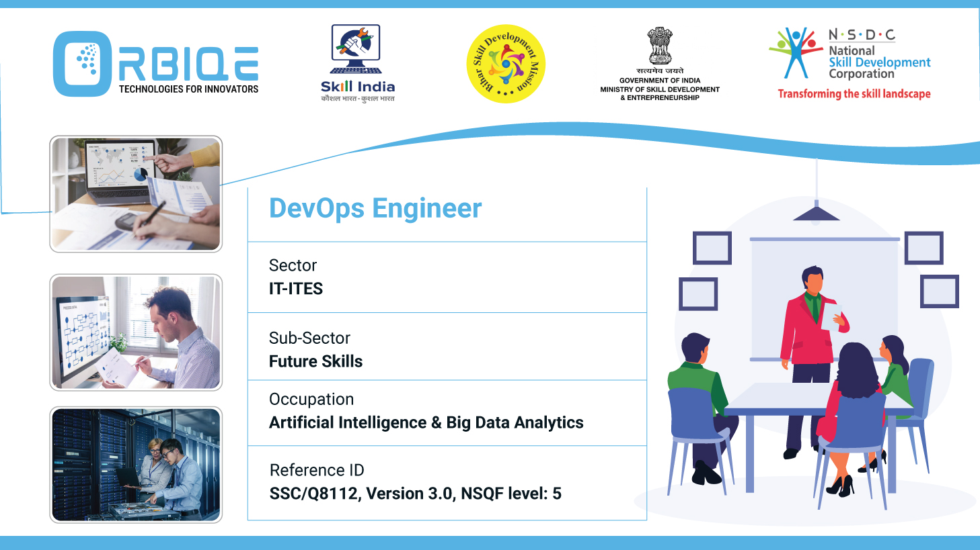
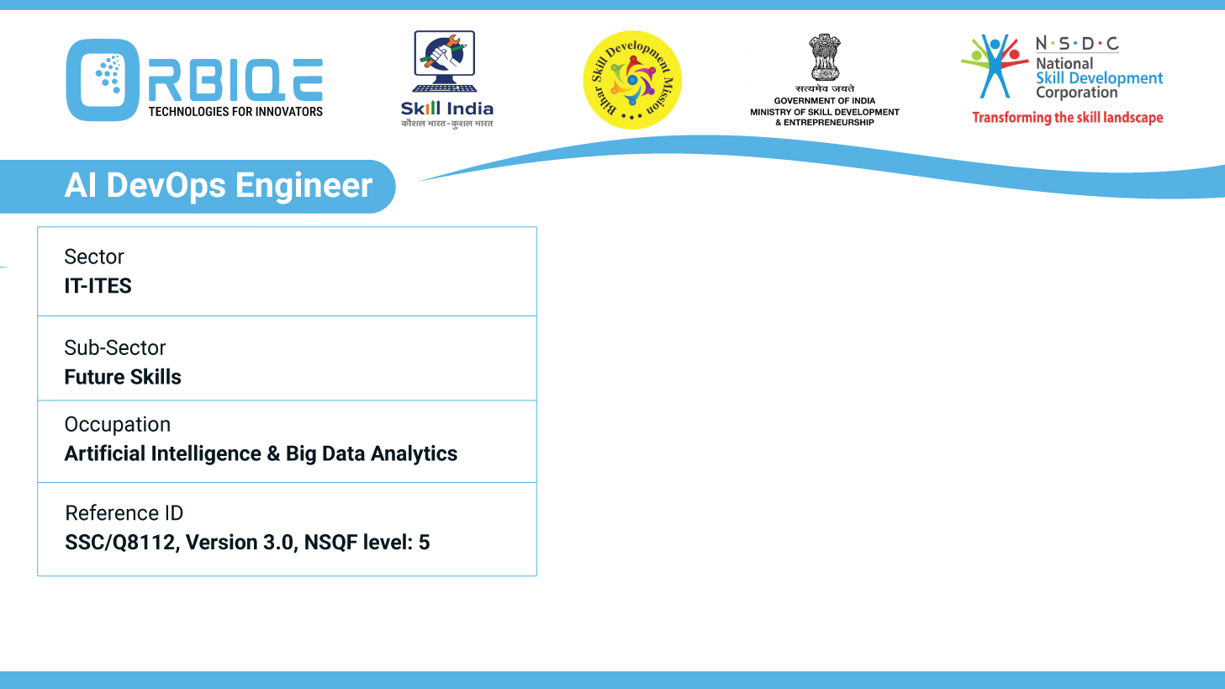
Name- Krishna Kant Dubey

Slide 2

Continuous and Automated Testing Routines

Slide 3
Agenda
Test Automation software
Application release automation tools
Automated testing routines

Slide 4
Continuous testing
Test Automation software (Selenium)

Slide 5
Application release automation tools
Puppet
Jenkins
TravisCI
BuildMaster

Slide 6
Automated testing routines

Slide 7
Thank You

